Slide 1

Software Development with Domain Driven Design and related Architecture
Empirical Research
anupam.Siwakoti@gmail.com
c7227267

Slide 2

Outcome from these research
This research covers, how we can apply paradigms of DDD with architectures such as Hexagonal architecture, CQRS event sourcing and layered architecture
Comparison between the performance and use case of these combination
A walk through for the fresh graduate or the developer with less idea on how enterprise software are developed

Slide 3

WELCOME NOTE
WHY THIS TOPIC
01
Software Development itself has become very advanced and complex in terms of technology and resources with the advancement of cloud computing and vast amount of data being circulated every second.
02
Every problem have different programming solution, having knowledge on programming itself is not sufficient for developing efficient and successful software's.
03
Domain Driven Design implementation has more failure rates than success, that’s because of lack of clear communication and hidden relationship between different aspects of business.
Anupam Siwakoti
04
Implementing DDD itself is not enough for the software, lots of external technologies should be integrated that’s why we combine it with different architectures.

Slide 4
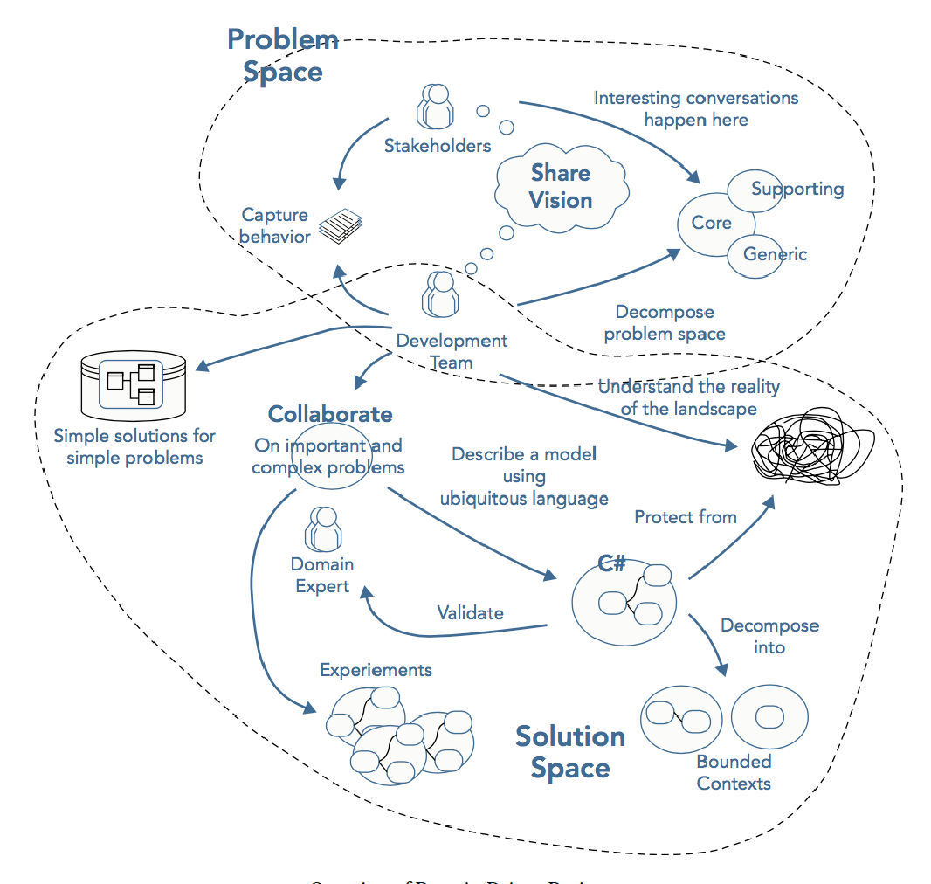
Domain Driven Design
Introduced by Eric Evan’s in 2003
Main principle, business domain must be the core of the software, mainly focuses on road map or say strategical design of the business.
DDD describes different approaches, tools and techniques which dissects business complexity and still manages to focus on the core business idea.
01
It not a pattern which can be followed rule wise, it’s the way of analyzing the relation between different aspects of the business and later generating relationship between them using classes and objects
02
“Big Ball of Mud,” which suggests that when a software works fine but can’t answer how its working then we will end up developing a software where it will be difficult to read and understand the codebase.
03

Slide 5
UBIQUITIOUS LANGUAGE
Common terms that both the business expert and developer agrees on while having conversation about the business
Domain Driven Design Constraints
Ubiquitous language
Business domain
Aggregates
Entities
Value Objects
Commands
Events
Saga
Bounded Context
Critical phase, limits the boundary of bounded context
Responsible for self speaking and self unrevealing software

Slide 6
Business Domain
Sub-domain
Business Domain: The services that the business promise to provide its customer
Sub-Domains
Core subdomain
Generic subdomain
Supporting subdomain
CORE SUBDOMAIN
The main motive behind building a software, or the problems that the software will solve to generate revenue.
GENERIC SUBDOMAIN
Subdomains which are a bit tough to work through and needs qualified human resource but doesn’t provide any competitive edge is termed as generic subdomain.
SUPPORTING SUBDOMAIN
out of three subdomains these are the simpler one, as name suggests it supports the other subdomains to work well.

Slide 7
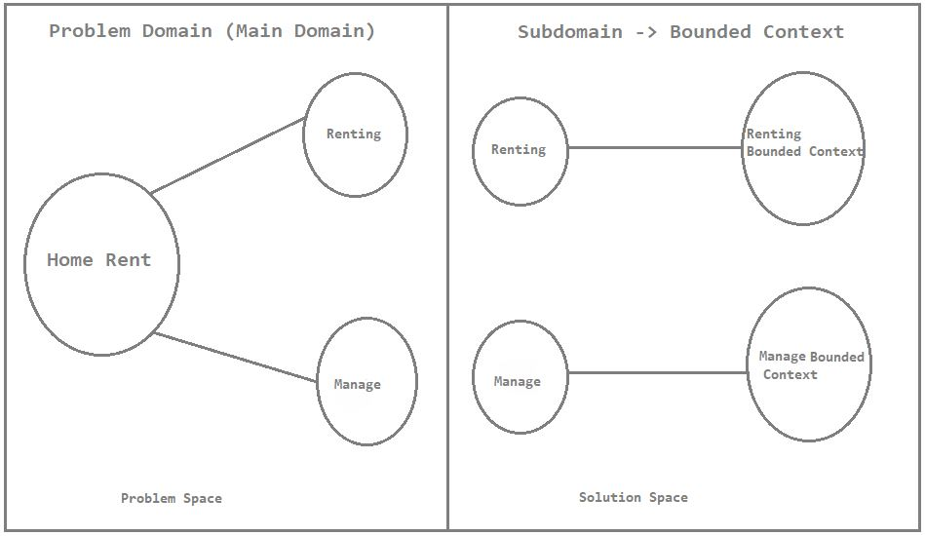
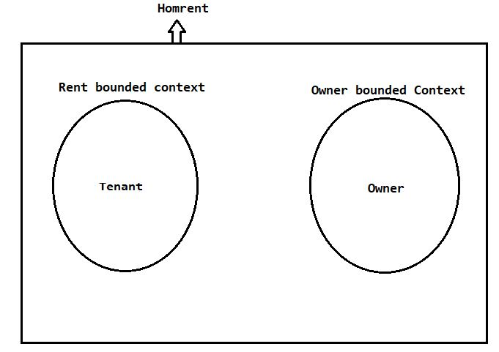
BOUNDED CONTEXT
Programming module that works under a same domain is encapsulated in bounded context
Bounded context segregates ubiquitous language in a context
Bounded context based on microservices

Slide 8
THE DOMAIN MODEL
Aggregates
Entities
Value Objects
Commands
Events
01
Traditional CRUD operation is not the answer, we deal with complex business rules, state transitions and invariants: rule that should not be crossed.
02
Domain model should be modeled such that it can manage the business complexity ensuring clarity of what the modules has to offer.
03
In short, the domain model is the actual implementation of business logic inside a specific bounded context.

Slide 9

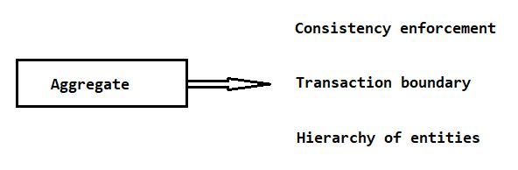
AGGREGATE
“Aggregate is an encapsulation around value objects and entities enforcing transactional consistency between them. ”
In case of our prototype: Homrent, in renting bounded context, we need to maintain state consistency with booking state, about tenants. Similarly, in manage bounded context, owner needs to have consistency with the flat him/her offers.
Aggregate is considered as central object that helps in maintaining consistency, everything in a domain model starts and ends with it.

Slide 10
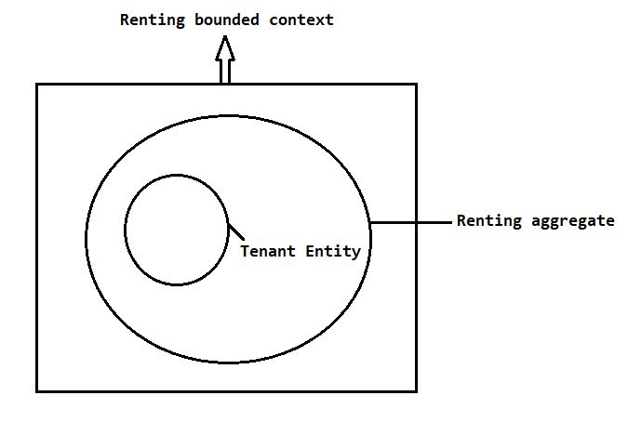
ENTITY
“It has its own uniqueness and identity”
The requirement for being an entity is that it must be unique for each instance of entity.
we have Tenant as an entity, it’s because a person who rents a flat is unique.
Entities are objects that has identity of its own and are unique.
The value of the entity remains immutable comparing that to value objects.
It can neither initiate nor end any of the activity in domain driven design.
It’s defined by value objects.

Slide 11
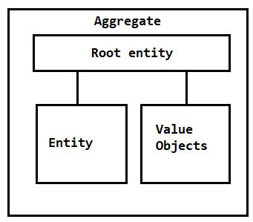
VALUE OBJECTS
“Unlike entities, value objects are mutable and doesn’t have any uniqueness in them”
There is no identity of its own, it’s just an object that carries value, That’s why its inside entity describing the entity.
value objects follow reference equality and structural equality
Let there be an object of bookingState b1 and its value be rented, similarly let there be another object b2 and its value be rented as well, comparing b1 and b2 should result in same.

Slide 12
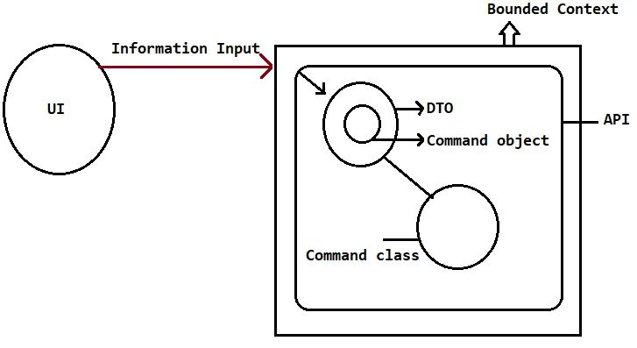
COMMANDS
“Command are basically the only instructions that are conveyed from UI to the endpoint”
They are the do-this-instruction to the aggregate and reason why aggregate changes its state.
Events are the result of command, but saying that what I mean is, whenever a command is executed because of it an event is generated.
In our prototype RentFlatCommand command contains the information that the user must sent it from the UI to make state change.
commands and events are the only pattern that changes the state of aggregate.

Slide 13
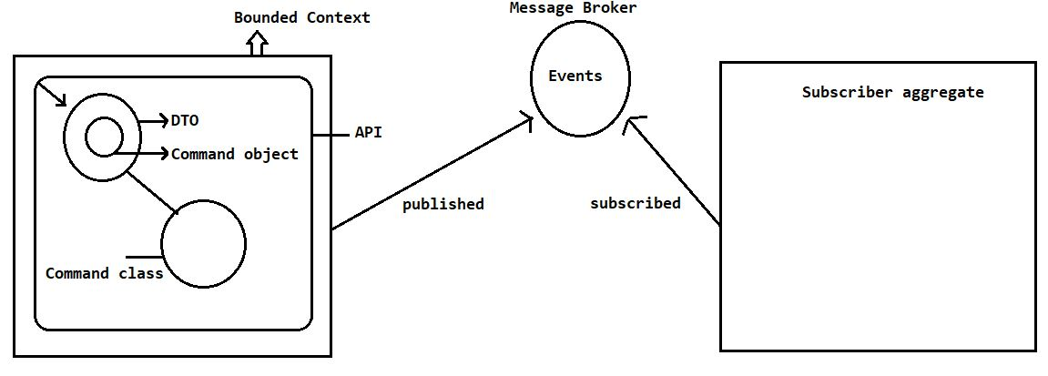
EVENTS
“Events are generally the after effect of command”
Domain Events are the message of what has recently happened for example, hotel booked, booking completed etc.
The goal is to describe an important task that has completed and carry important information regarding the completion of the task.
As everything starts and ends with an aggregate, events are published by an aggregate, other interested aggregate or module can subscribe to it.
In our prototype, we have an event FlatBookedEvent, whenever a flat is booked, rent aggregate raises this event.
Events are published from one aggregate and are subscribed by another aggregate.

Slide 14
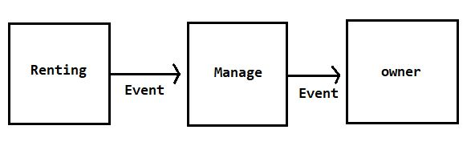
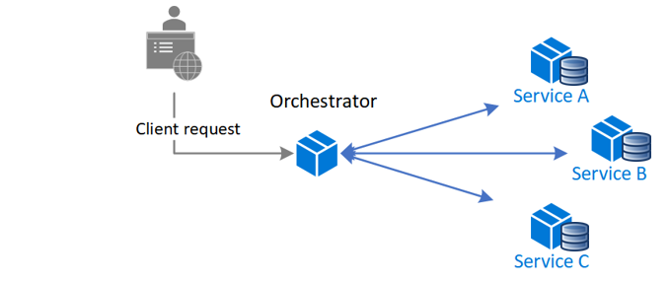
SAGA
“Flushing out business process inside a business domain is called saga”
Aggregate is the participant of the saga; they react to multiple events and orchestrate the business process.
Sagas encapsulates this steps that spans around multiple bounded contexts.
Sagas listens to the event published by any of the context and fires commands to the subsequent components.
The only responsibility it carries is if any step inside of saga is terminated the whole process should be re-evaluated to the step that it was in
before the start of the saga.
CHOREOGRAPHY SAGA
ORCHESTRATION SAGA
In choreography saga, all events and commands are handled by their own handlers, there is no component that handles this entire process.
In orchestration saga, the responsibility of handling a entire process that includes multiple publication of events and invocation of commands is given to a single component

Slide 15
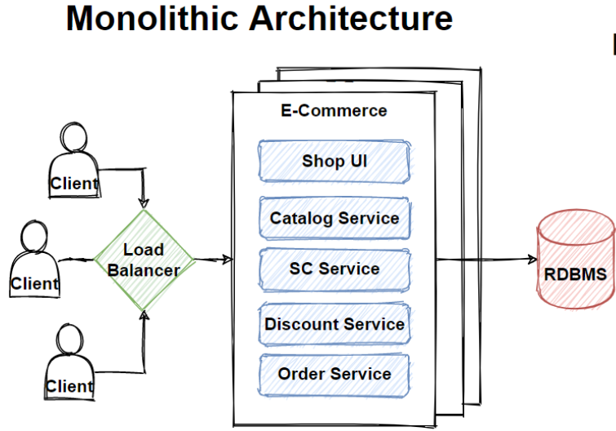
MONOLITH ARCHITECTURE
HOSTED UNDER SAME WAR FILE
Every bounded context is packed under same WAR file and deployed together. Although it reduces the need for external dependencies such as RabbitMQ, Kafka etc., and is quite simple to bring in use but it doesn’t meet the demand for software built today.
Enforcing Transactional Consistency
Easier maintainability
Centralized data management
Compact relationship among modules
LOVED BY PEOPLE

Slide 16
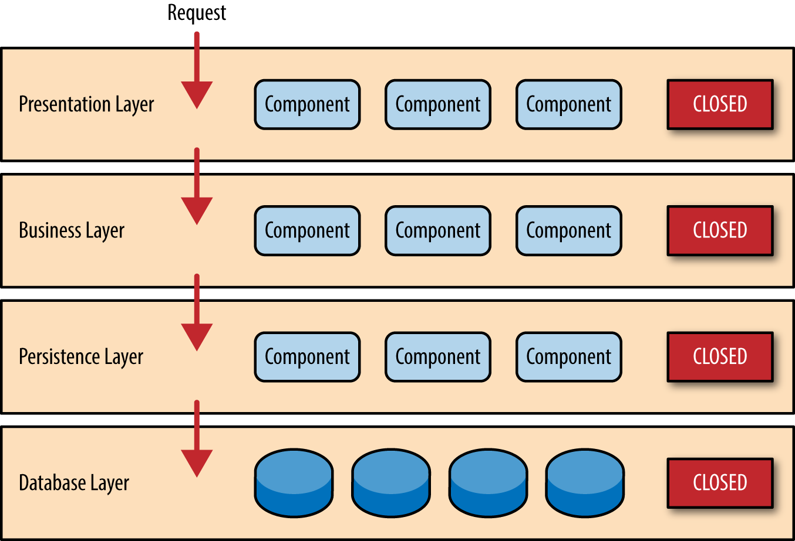
LAYERED ARCHITECTURE
01
02
Layered or N-layered architecture is considered as traditional software architecture as its barely used in designing today’s software.
Each layer is highly dependent upon the layer just above it, high dependency between two layers.
03
Persistence layer is highly dependent upon data-access layer rather the focus needs to be given to business logic

Slide 17
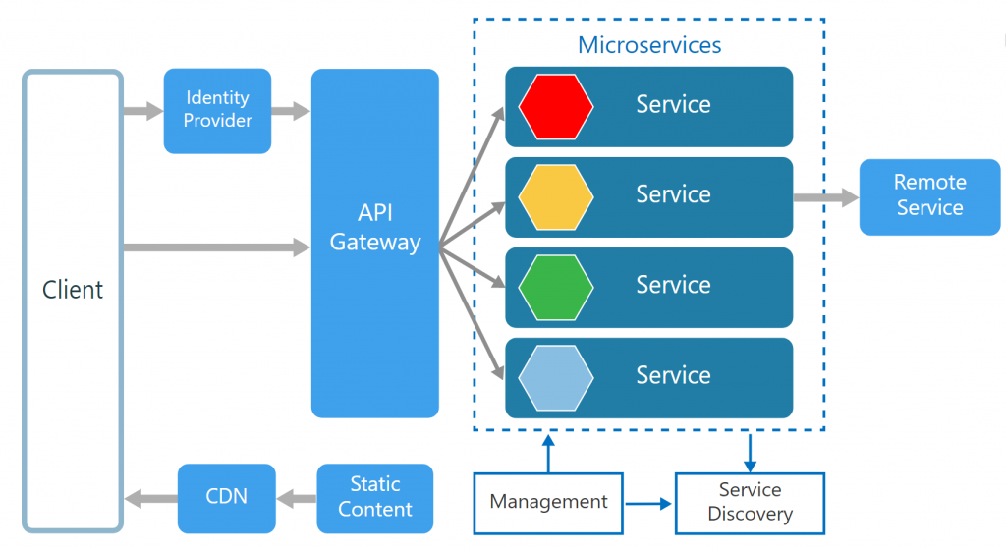

MICROSERVICES
EACH SERVICE IS HOSTED SEPERATELY
Every bounded context is packed under same WAR file and deployed together. Although it reduces the need for external dependencies such as RabbitMQ, Kafka etc., and is quite simple to bring in use but it doesn’t meet the demand for software built today.
Enforcing Eventual Consistency
Easier and separate maintainability
Distributed data management
Separation of concern

Slide 18
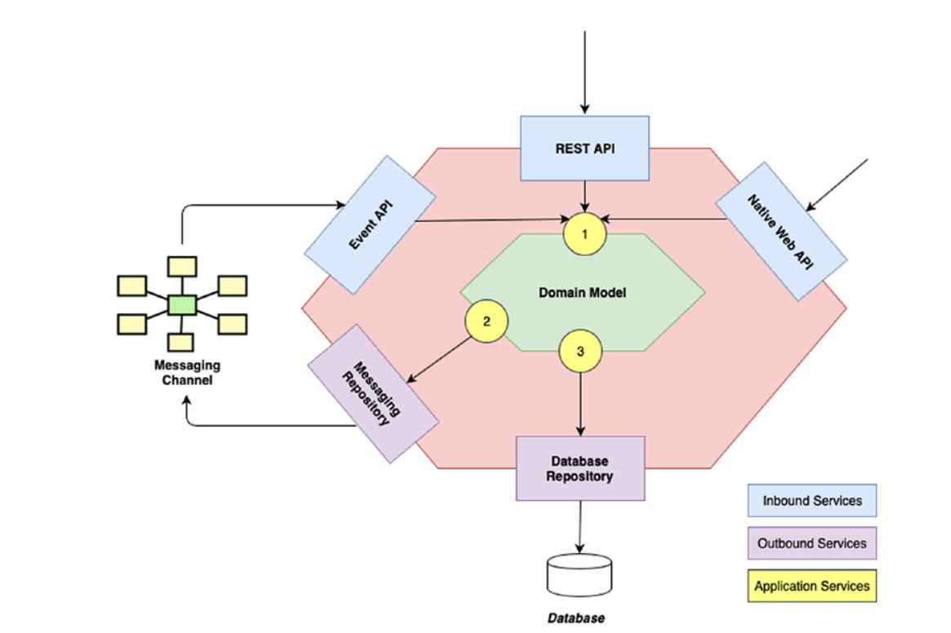
HEXAGONAL ARCHITECTURE
Also called as port and adaptors, hexagonal architecture looks like a hexagonal when we draw its specifications.
01
02
INBOUND SERVICE
OUTBOUND SERVICE
An inbound port facilitates an interface through which inbound adaptors can send information to the actual business logic layer.
An inbound adaptor in technical word is a class that incorporates external messages, basically a listener to the request made by any of the client.
An outbound port provides an interface that helps in either publishing the events from the domain model or persists the change.
An outbound adaptor receives the instructions from the outbound adaptors and does accordingly

Slide 19
HEXAGONAL ARCHITECTURE CONTD..
Also called as port and adaptors, hexagonal architecture looks like a hexagonal when we draw its specifications.
01
02
DEPENDENCY INVERSION
INTEGRATION WITH MICROSERVICES
In hexagonal we invert the dependency of logic layer with data layer. In this layer our business model is the one in the center.
The domain model is free from any dependency.
Extension of new functionality is easy.
Each bounded context follows the hexagonal architecture and hosted in separate service

Slide 20
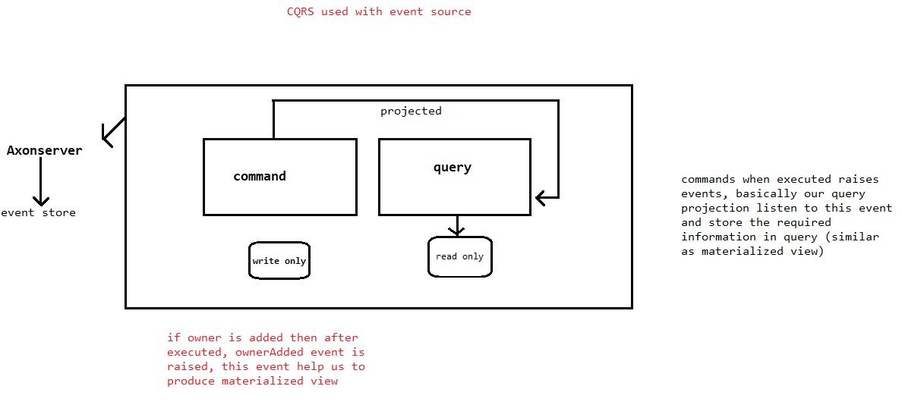
CQRS AND EVENT SOURCING
Event sourcing is based on completely different ideology, we base our persistence on time and events.
CQRS means segregating command and query responsibility
EVENT SOURCING
Everything is based on events In event sourcing
Event store is the ultimate source of truth
Traversal through time is possible
Best results when used with CQRS
Completely different than traditional approach, we need to consider working of our software in terms of events.
Projection logic is used
Eventual consistency

Slide 21
CQRS AND EVENT SOURCING CONTD..
Event sourcing is based on completely different ideology, we base our persistence on time and events.
CQRS means segregating command and query responsibility
CQRS
There are two separate modules for both command and query.
Along with separate modules they have separate flow, persistence mechanism, separate logical process.
Under command module we see write only database, a command generally is what make changes to an aggregate so it can use database system that is better at storing the data.
Query side uses database technology that priories analytical components.

Slide 22
THIS IS THE
END OF THE PRESENTATION
THANK YOU
For Your Attention, I am Appreciated

